Slide 1
Inventory Management System
Website and Mobile Applications
Kyle Parker
Christopher Andrews
Sarim Janjua
Erik Wojcik
Quentin Terry
Mohib Ahmed
Chaitanya Chakka
Nicholas Turner

Slide 2
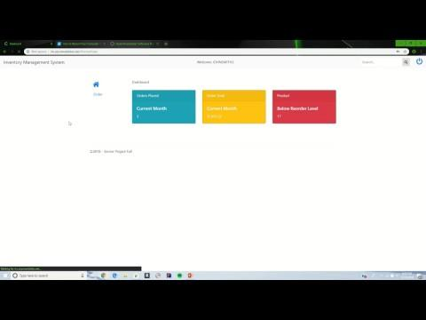
Login

Slide 3
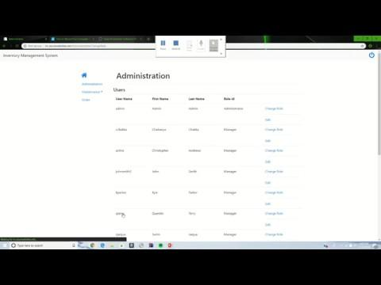
Administration

Slide 4
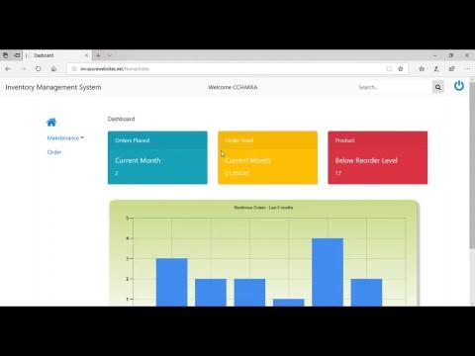
Dashboard / Order / NLS

Slide 5
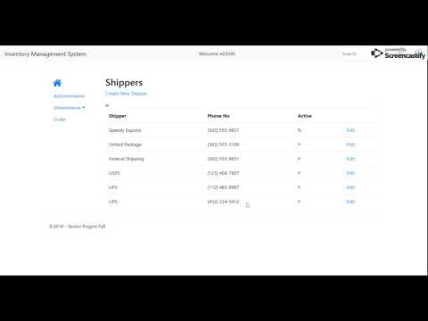
Shippers

Slide 6
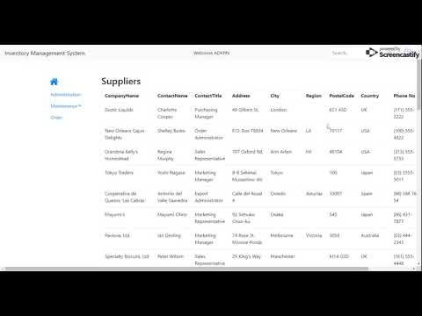
Suppliers

Slide 7
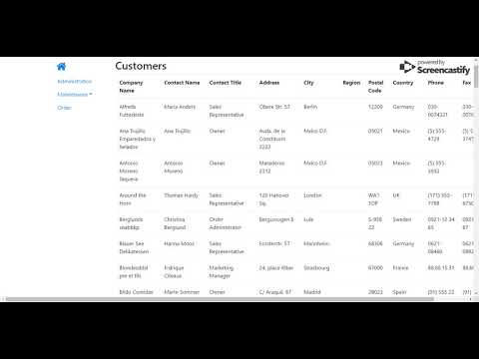
Customers

Slide 8
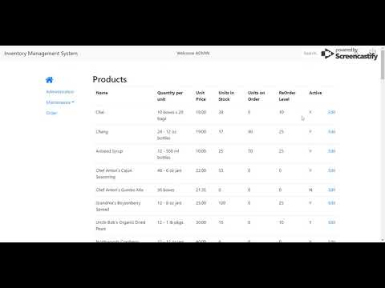
Products

Slide 9

Mobile Application Demo

Slide 10
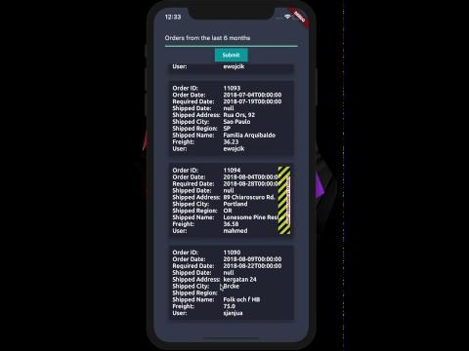
Mobile Application - Natural Language Demo

